Slide 1
Zooey - Virtual Assistant
John Aromando & Diego Holguin

Slide 2
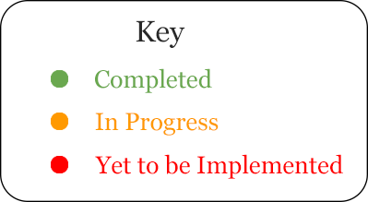
Features
Voice Recognition
Google Search
36 Mathematical Calculations
Text to Speech
Pause
Scheduler/Calendar
Spotify
Bring Window to Foreground/Minimize
Chat Room
Open/Close File
File Search Algorithm
Turn Lamp On/Off
Networking All Devices on Network

Slide 3
What Makes Zooey Special
Relevance
Expands domain
Push limits of how technology can aid humanity
Novelty
Completely Hands Free
Household Help
PC Focussed
Social/Ethical Impacts
More User Freedom
Aid for the Disabled

Slide 4
Questions?
Thank You!!

